Slide 1
How has the relationship between pay and productivity in the UK transformed in recent decades?
A study on the commonly held belief that greater productivity will translate to greater living standards.

Slide 2

“
Productivity isn’t everything, but, in the long run, it is almost everything. A country’s ability to improve its standard of living over time depends almost entirely on its ability to raise its output per worker.
- Paul Krugman, The Age of Diminished Expectations, 1990
Notes:
In his book “the age of diminished expectations”, Paul Krugman states that:

Slide 3
Outline
Motivation and policy climate,
Existing literature and value added,
Empirical Strategy,
Data and results,
Discussion of findings, policy prescriptions, and future research.

Slide 4

Motivation

Slide 5



1990
1956
2024
Notes:
Krugman’s view is not unpopular – the idea that productivity increases living standards is shared across the economics discipline, from Krugman in 1990 to Robert Solow in 1956, and by contemporary members of British government, most clearly the Chancellor of the Exchequer, Rachel Reeves in 2024.

Slide 6

Rachel Reeves, Mais Lecture, 2024
“
At root, productivity remains the key medium term determinant of wages. It is the collapse in our productivity growth which explains our wage stagnation.
Notes:
Rachel Reeves’ focus on productivity was made clear in her Mais Lecture in 2024. She stated:

Slide 7



The ‘coupled’, or ‘linked’, view of wages and productivity
In other words, a rise in productivity will lead to a rise in wages.
On the other hand, we have:
Notes:
These three thinkers form what I call the “coupled”, or “linked” view between wages and productivity. In essence, productivity is the most important determinant of wages. A rise in productivity will lead to a rise in wages. Clearly, this view is quite dominant in the academic and political sphere. On the other hand…

Slide 8
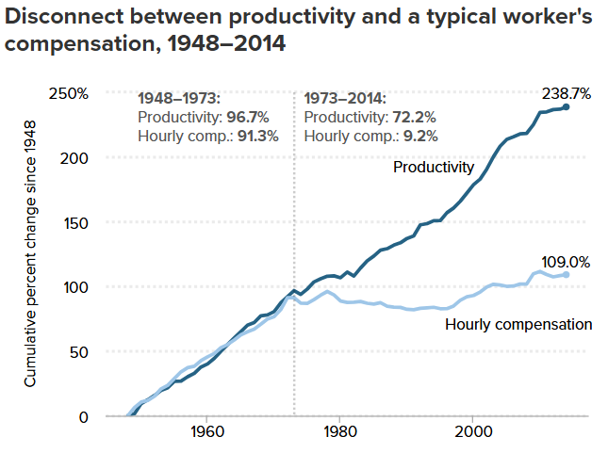
… the ‘decoupled’, or ‘delinked’, view of wages and productivity
The Productivity–Pay Gap
Understanding the Historic Divergence Between Productivity and a Typical Worker’s Pay
Report • By Josh Bivens and Lawrence Mishel • September 2, 2015
Notes:
We have the “decoupled”, or “delinked” view of productivity and wages. This view is equally not without support, both in the academic world and the political realm. The productivity-pay gap graph shown on the right has become a popular way in recent years of arguing that the typical worker in the US doesn’t gain from productivity growth.

Slide 9

Joe Biden, 2021
“
[…] and then along came 1979 and everything began to change. Productivity in the country has grown almost four times faster than pay since 1979. That means that workers have been giving much more to their employers’ bottom lines than they’ve gotten back in their pay-checks.
Notes:
The sentiment was echoed most famously by Joe Biden: in 2024, he said in a speech:
These opposing views are important. If it really is the case that extra productivity is not transmitted to wage growth, then the UK government and many academics must rethink the predominant policy proposals set out to increase standards of living.
It’s clear that this question has raised a lot of eyebrows, and it needs a clear and robust answer, to either ease concerns or urge policymakers to change course.

Slide 10
My study did not restrict its investigation to one income measurement.
Median and mean gross earnings, and total labour compensation, are investigated with respect to productivity.
The UK does not collect data on ‘production/non-supervisory’ worker pay, but this is approximated by the median gross earnings rate.
Notes:
It’s true that standard of living means something slightly different from wages, however I am taking median wages to be a good estimate for living standards.
Gross earnings are slightly different from labour compensation, and in an effort to ease confusion, all three income measurements will be examined as dependent variables.

Slide 11
Key Terminology
Gross Earnings vs. Labour Compensation?
Gross earnings designates untaxed income.
Labour Compensation includes gross earnings, plus non-wage benefits, such as bonuses and pension contributions.

Slide 12

Policy Climate

Slide 13
The state of productivity-pay divergence in the UK
Looking at hourly median gross earnings.
Notes:
From my own analysis, this is the state of productivity-pay divergence in the UK since 1997.
This time series looks at hourly median gross earnings against labour productivity. We can see that both clearly diverged in 2010, with productivity flatlining and real median wages falling.

Slide 14
The state of productivity-pay divergence in the UK
Looking at all income types.
Notes:
Going further, we can see how average wages, and average total labour compensation, have changed over the same time period.
Mean wages have grown faster than median wages, implying growing income inequality. Average labour compensation has grown even faster than productivity, however all three different income measures have flatlined since the 2008 recession.

Slide 15

Existing Academic Literature on the UK’s pay-productivity gap
Notes:
Combining these findings with the existing literature will help us to understand the current pay-productivity climate in the UK.

Slide 16
Divergence of Pay and Productivity
Divergence is mainly due to a rise in income inequality. (Pessoa & Van Reenen, 2013; Teichgraber & Van Reenen, 2021)
1% increase in productivity leads to either an insignificant, 0.151%, and 0.225% increase in median wages at the firm, industry, and local labour market levels, respectively. (Ciarli, Salgado & Savona, 2018)
A 1% increase in productivity led to a 0.35% and 0.26% increase in median wages, across a 5-year and 10-year time horizon, respectively. (Ciarli, Di Ubaldo & Savona, 2021)
Notes:
An important body of literature argues that rising income inequality means median wages are no longer affected by productivity growth.
A second body of literature calculated elasticities for median wage growth, finding x x x x.
Problem with the studies I’ve highlighted in blue: they are qualitative, and cannot tell us much about the precise relationship between pay and productivity. Even if two series appear to diverge over, they could still be correlated.
Problems with those highlighted in orange: they don’t account for lagged effects, which there is reason to believe make a big difference.

Slide 17

How can these problems be remedied for fuller analysis?
Incorporate lags and controls (inflation, unemployment) and perform quantitative analysis (Stansbury & Summers, 2018; Pasimeni, 2018; Brocek, 2019; Nasir et al., 2022).
Elasticities of 0.72% (Stansbury & Summers, 2018) and 1.54% (Brocek, 2019) are found for median wages.
Notes:
The studies which do implement these additions find these elasticities:

Slide 18

Value Added

Slide 19
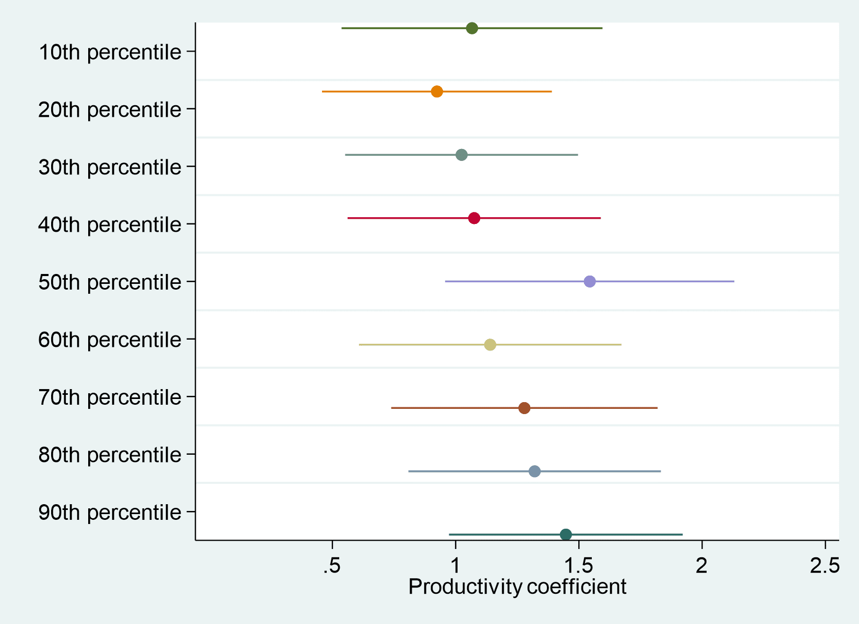
Brocek (2019) approaches a good level of analysis, however there are still problems.
The timeframe only spans from 1999-2017,
I expand to 1997-2019
Brocek (2019) does not undergo any robustness checks,
Does not control for inflation
Does not investigate mean wages or labour compensation as dependent variables.
Notes:
Brocek’s research is the most similar study which has been conducted to my own.
This is because other studies investigated either do not estimate models with median wages, or are not based in the UK.
However, there is still a difference between mine and Brocek’s analysis which allows me to add value to the existing body of work.

Slide 20

Empirical Strategy

Slide 21
Baseline Model
$$Δlog{wages_{t}=β_{0}+β_{1}Δlog{prod_{t}+β_{2}Δunemp_{t}+β_{3}Δunemp_{t−1}+β_{4}Δinf+ε_{t}}}$$
Notes:
Variables are logged to calculate elasticities and differenced to ensure stationarity.
Unemployment and inflation are not logged as they are measured in percentages

Slide 22
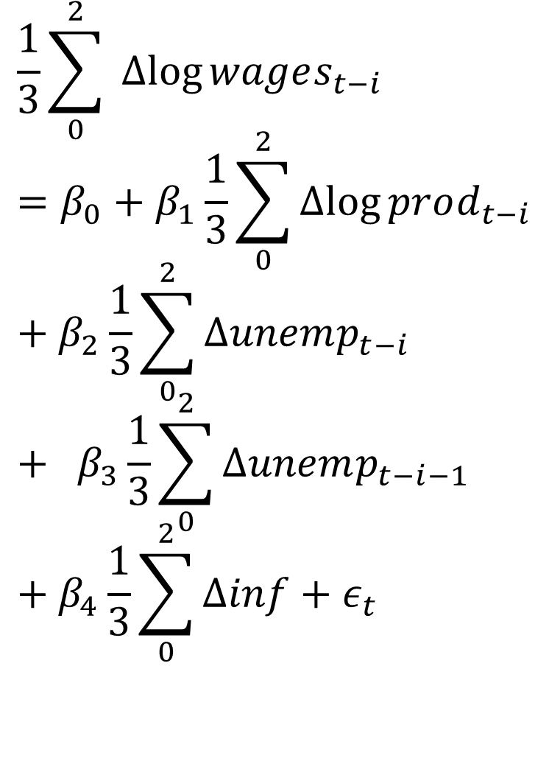
Accounting for lagged effects
$$\frac{1}{3}\sum_{0}^{2}{ Δlog{wages_{t−i}}}=β_{0}+β_{1}\frac{1}{3}\sum_{0}^{2}{Δlog{prod_{t−i}}}+β_{2}\frac{1}{3}\sum_{0}^{2}{Δunemp_{t−i}} + β_{3}\frac{1}{3}\sum_{0}^{2}{Δunemp_{t−i−1}}+β_{4}\frac{1}{3}\sum_{0}^{2}{Δinf}+ε_{t}$$
Variables are estimated in 3-year moving average form to account for lagged effects.

Slide 23

Data

Slide 24
Data
Data is varied for robustness tests.
Median Total Labour Compensation is not available in the UK.
2015 prices
2019 prices
Notes:
On the left we can see median and mean wages, and average total labour compensation.
On the right we can see productivity measured in four different ways. This covers the different definitions used in the academic literature and the ONS, just in case different definitions change the final result.

Slide 25
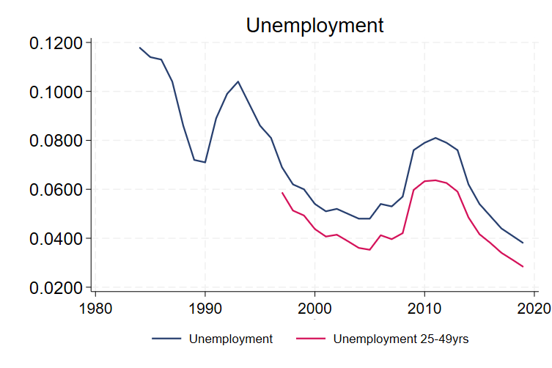
Data
Some data shown dates before 1997.
Notes:
CPI inflation is used, rather than RPI, simply due to the higher quality of the index as attested to by the ONS.
Unemployment is slightly modified: the total unemployment figures might indirectly capture effects of demographic shift over time, as the population ages. To avoid this, the unemployment rate of 25-49 year olds is used instead.

Slide 26

Results
Notes:
What did I find? Is productivity still an important goal for policymakers? Or should we be looking elsewhere?

Slide 27
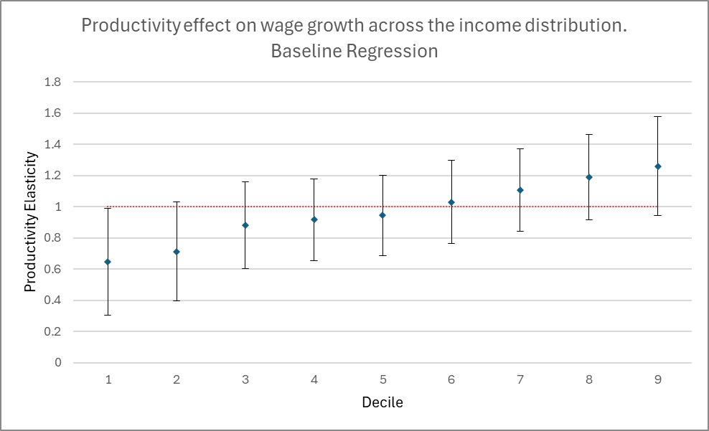
Results – Baseline
Notes:
This is the baseline regression, where different deciles of the income distribution are regressed against labour productivity. The red line highlights the section where the elasticity is unity.
As wages increase, the benefit from productivity growth increases. The bottom 10% has an elasticity of 0.65% whereas the top 10% has an elasticity of 1.25%. The median has an elasticity of roughly 1%. This clearly shows strong inequality effects.

Slide 28
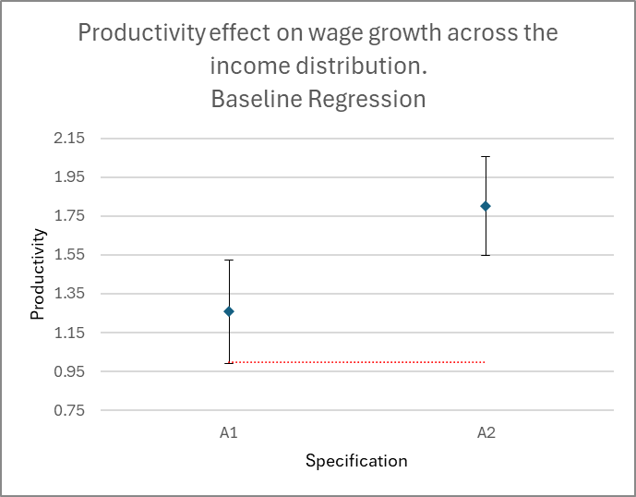
Results – Alternate Specifications
Productivity Effects, Alternative Specifications
Notes:
These alternative specifications look at the mean, rather than median. A1 is mean wages and A2 is average labour compensation.
Both variables experience greater than one-to-one growth with productivity. Average wages rise, on average, by 1.2% and average labour compensation rises by 1.75%, when productivity grows by 1%.

Slide 29
Main Findings
There is strong correlation between wage growth and productivity, at both the average and median levels. As such, labour’s share of income has certainly increased.
The ‘linkage’ or ‘coupled’ assertion made by Krugman, Reeves, and Solow are supported by the evidence: productivity is the dominant determinant of wages.
Examining lagged effects is both theoretically justified and produces significant, positive results.
Unemployment and inflation also have significant effects on wage growth.
Notes:
TO add to this, the original productivity elasticity assertions, made by papers I previously looked at, are no longer very credible.

Slide 30
Main Findings
Inequality effects are significant – lower income deciles benefit less on average, via wage growth, from average labour productivity growth.
Why do these inequality effects exist? At the moment, the answer is not clear.

Slide 31
Labour Bargaining Power
In their analyses, Pasimeni (2018) and Nasir et al. (2022) argue that the unemployment regression coefficient also captures the effects of labour bargaining power.
This viewpoint borrows from efficiency wages theories (Stiglitz & Shapiro, 1984; Akerlof & Yellen, 1990)
Notes:
Stansbury & Summers (2020) Nasir et al. (2022) and Pasimeni (2018) all argue that low labour bargaining power is the most important factor weakening transmission from productivity to wages.

Slide 32
Labour Bargaining Power
Increasing labour bargaining power is not a straightforward way to increase real wages.
Conflict theories of inflation imply that greater labour bargaining power can cause wage-price or price-wage spirals to emerge during pay disputes.
Existing research from Blanchard (2004) suggests that if trust exists between labour and capital groups, wage-price spirals can be avoided even with high union density.

Slide 33
Policy, to summarise:
Increasing productivity is critical if policy makers are aiming to boost living standards, wages, and total labour compensation.
Keeping inflation and unemployment low also helps real wage growth.
Greater labour bargaining power will help too; however, this must be paired with active policies to strengthen trust.
Weak labour bargaining power likely explains growing pay-productivity divergence.
Notes:
Increasing productivity is critical if policy makers are aiming to boost living standards, wages, and total labour compensation. There is very little evidence to support the idea that raising productivity does not raise wages, and more evidence to the contrary.
Keeping inflation and unemployment low also helps real wage growth, although these aims are already institutionally embedded policy goals in the UK.
Greater labour bargaining power will help too, however this must be paired with active policies to strengthen trust between labour and capital owners, and responsiveness to demands from both sides, to ensure that trust is not broken.
It is this weak labour bargaining power which likely explains the wide divergence seen between median wages and average labour productivity.

Slide 34

Future Research

Slide 35
Improvements to the methodology
and gaps for further research.
Further investigation is needed to examine labour productivity distribution.
This tells us: will more labour bargaining power reduce inequality effects, or is labour productivity distribution itself unequal?
Depending on the answer, redistribution policies might therefore be most credible way to ease income inequality.
Notes:
One key question that has not been investigated in the literature, as far as I can tell, is where exactly the source of inequality in productivity growth effects on wages comes from.
On one hand, lower wage workers likely have lower bargaining power – this could result in productivity gains more easily being extracted by capital owners.
On the other hand, lower wage workers are likely less productive in the first place, and so there is simply less income for them to receive, even with their full productivity benefits.
Further investigation is needed to examine the labour productivity distribution curve.

Slide 36
References
Bivens, J., & Mishel, L. (2015). Understanding the Historic Divergence Between Productivity and a Typical Worker’s Pay. Economic Policy Institute.
Blanchard, O. (2004). Explaining European Unemployment. NBER.
Brocek, F. (2019, August 26). Is the link between labour productivity and wage growth still alive in the UK? (University of Strathclyde) Retrieved from Fraser of Allander Institute: https://fraserofallander.org/link-labour-productivity-wage-growth-uk/
Casanova, J., & Andrés, C. G. (2014). Twentieth-Century Spain: A History. Cambridge: Cambridge University Press.
Ciarli, T., Di Ubaldo, M., & Savona, M. (2021). The weak link between productivity and wages in London: Evidence from firms and local labour markets (2004-2014). London: The Greater London Authority.
Ciarli, T., Salgado, E., & Savona, M. (2018). Do Low-Wage Workers Benefit from Productivity Growth Recovery? Joseph Rowntree Foundation.
Krugman, P. (1990). The Age of Diminished Expectations. Cambridge, MA: MIT Press
Nasir, M. A., Wu, J., Howes, C., & Ripley, H. (2022). Asymmetric nexus between wages and productivity in the context of the global financial crisis. Journal of Economic Behaviour and Organisation, 164-175.
Pasimeni, P. (2018). The Relation between Productivity and Compensation in Europe. Luxembourg: European Commission.
Pessoa, J. P., & Van Reenen, J. (2013). Decoupling of Wage Growth and Productivity Growth? Myth and Reality. CEP Discussions Papers.
Reeves, R. (2024, March 18). Rachel Reeves Mais Lecture 2024. Retrieved from Labour Webpage: https://labour.org.uk/updates/press-releases/rachel-reeves-mais-lecture/
Stansbury, A. M., & Summers, L. H. (2018). Productivity and Pay: Is the Link Broken? Peterson Institute for International Economics Working Paper No. 18-5.
Stansbury, A. M., & Summers, L. H. (2020). The Declining Worker Power Hypothesis: An Explanation for the Recent Evolution of the American Economy Brookings Papers on Economic Activity, Spring 2020.
Solow, R. M. (1956). A Contribution to the Theory of Economic Growth. The Quarterly Journal of Economics, 65-94.
Teichgraber, A., & Van Reenen, J. (2021). Have Productivity and Pay Decoupled in the UK? International Productivity Monitor, 31-60.

Slide 37
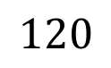
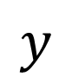
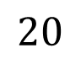
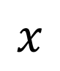

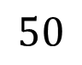
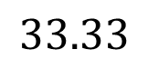
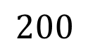
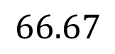
$$Production Possibilities Frontier$$
$$y$$
$$50$$
$$33.33$$
$$20$$
$$UPF$$
$$x$$
$$66.67$$
$$120$$
$$200$$

Slide 38
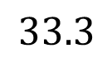
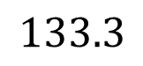
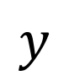
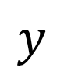
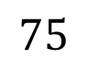
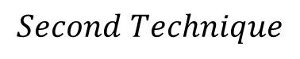
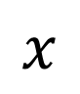
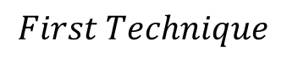
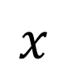
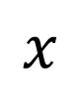
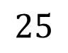
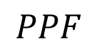
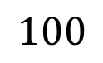
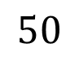
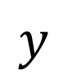
$$First Technique$$
$$Second Technique$$
$$y$$
$$Production Possibilities Frontier$$
$$75$$
$$y$$
$$y$$
$$50$$
$$PPF$$
$$25$$
$$x$$
$$x$$
$$x$$
$$100$$
$$33.3$$
$$133.3$$

Slide 39
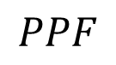
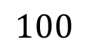
$$Production Possibilities Frontier$$
$$y$$
$$50$$
$$PPF$$
$$x$$
$$100$$

Slide 40
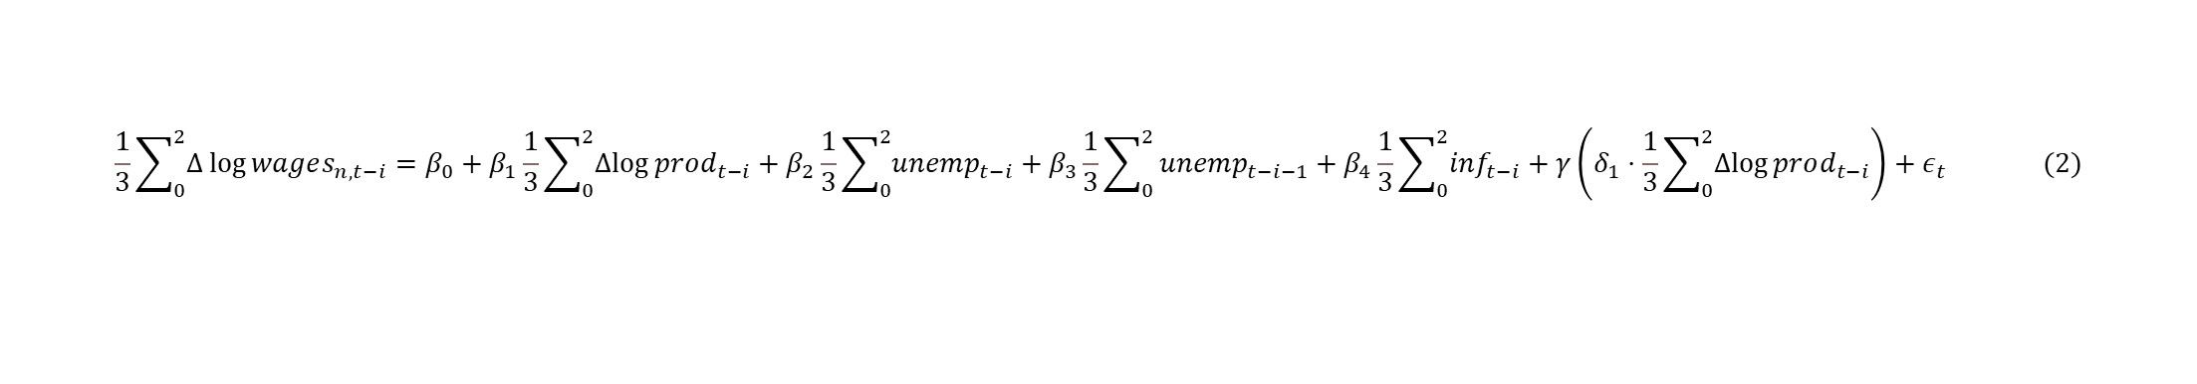
$$\frac{1}{3}\sum_{0}^{2}{Δ\log{wages_{n,t−i}}}=β_{0}+β_{1}\frac{1}{3}\sum_{0}^{2}{Δlog{prod_{t−i}}}+β_{2}\frac{1}{3}\sum_{0}^{2}{unemp_{t−i}}+β_{3}\frac{1}{3}\sum_{0}^{2}{unemp_{t−i−1}+β_{4}\frac{1}{3}\sum_{0}^{2}{inf_{t−i}}+γ\left(δ_{1}⋅\frac{1}{3}\sum_{0}^{2}{Δlog{prod_{t−i}}}\right)+ε_{t}} (2)$$

